Slide 1
A Compressed RAM Service
Making Sense of a device that lies about capacity

Slide 2
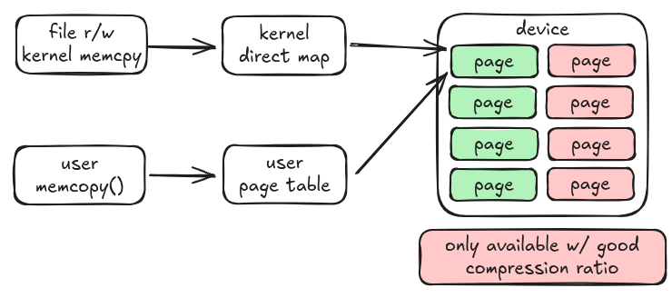
Core Problem: A Lying Device
Failure to hit a compression ratio: `struct page` points to nothing.
e.g. “Real vs Perceived Capacity” - kernel has no concept of this.

Slide 3
Requirements / Mechanisms
NOT SWAP - just offloading compression is pointless
Write Control (write-fencing - Read-only, promote on write)
Allocation Control (usage exceeds real capacity)
Dynamic Sizing (Ballooning)
Normal Folios (not ZONE_DEVICE)
Accounting (How do we drive OOM)
The kernel can actually already satisfy most of these.

Slide 4
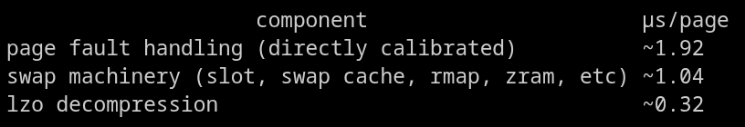
Why Not Swap?
measurements from Kairui Song
Best Case: Decompression is <10% of the cost of a swap fault.
The real win is getting rid of the fault.

Slide 5
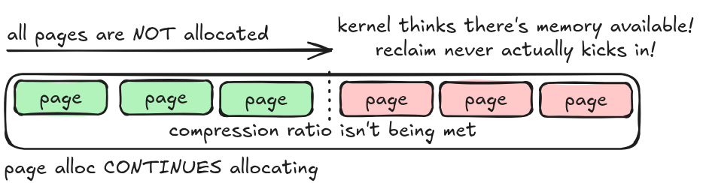
Allocation Control
Without allocation control, reclaim is broken.
The Control: All allocations happen at reclaim time.

Slide 6
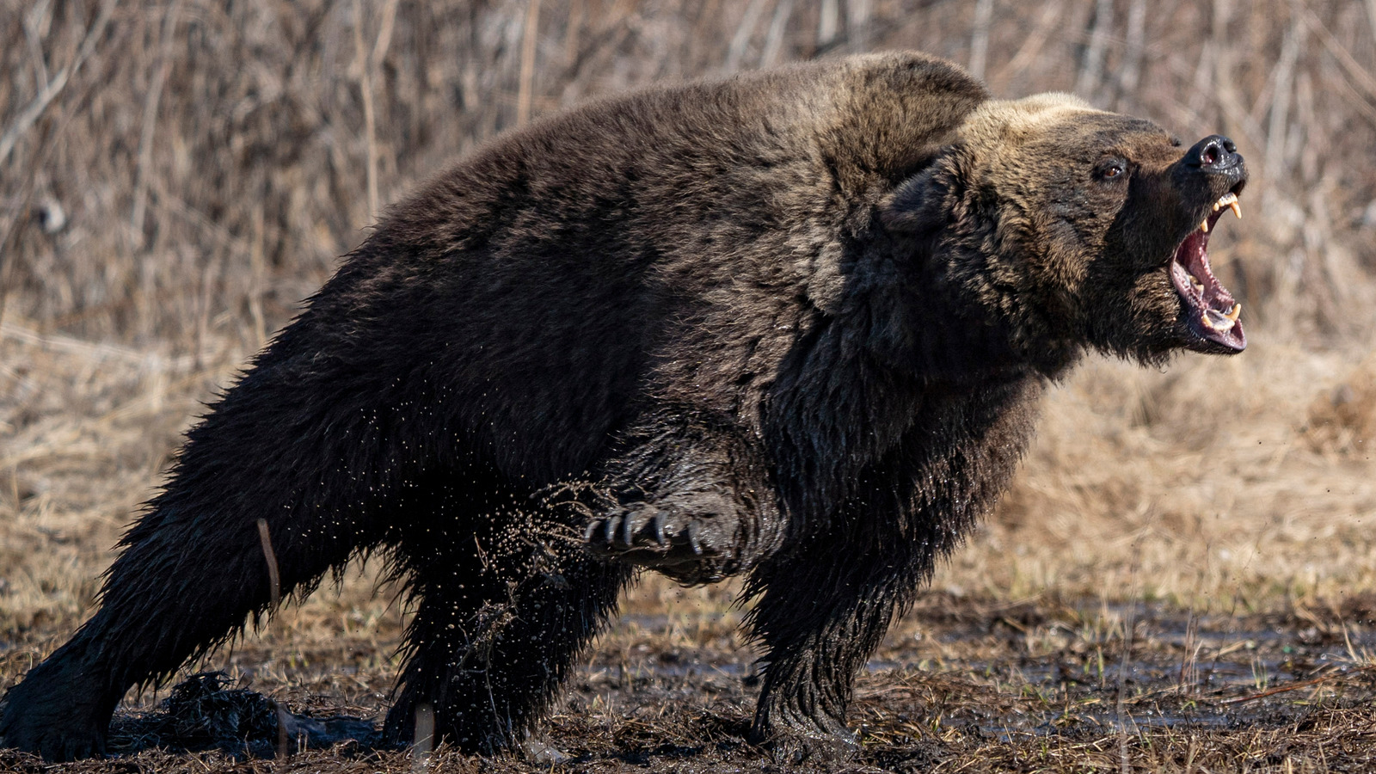
Write Control (Read-only)
You cannot outrun a bear
You cannot out-reclaim a writer.
Coherent link allows many GB/s
The Poison-storm will destabilize your system and you will be :(

Slide 7
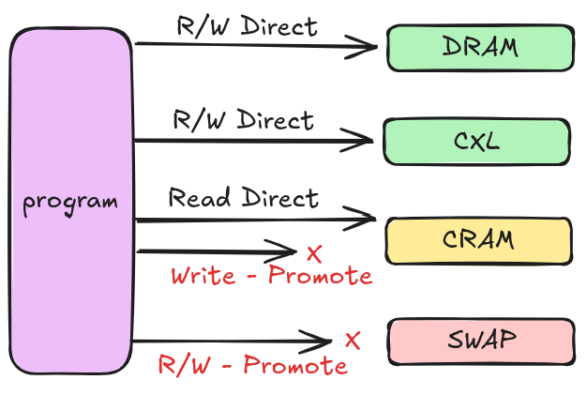
Write Control
Simple Solution:
Allow Direct Read
Promote on Write
Anon-only is very clean (R/O PTE)
Files are harder.
clean-cache design can work.

Slide 8
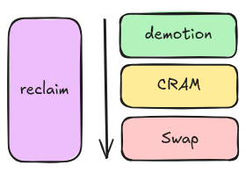
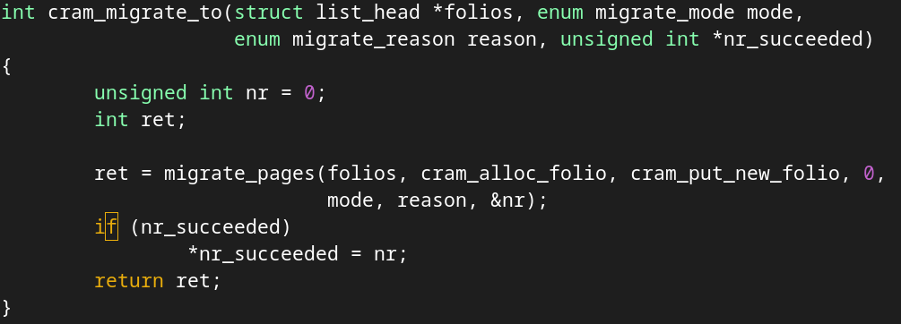
High level implementation
Private NUMA Node + Migration + Balloon + Chicken Bit
(Chicken-bit: Driver says NOPE, STOP ALLOWING NEW ALLOC)

Slide 9
Voiced Concerns - R/O Perf
Is a read-only tier really going to work?
Zswap works. Zram works. Swap works.
These are all PROT_NONE tiers.
The question is how much R/O tier is too much?
Maybe we can optimize that by moving capacity between nodes

Slide 10
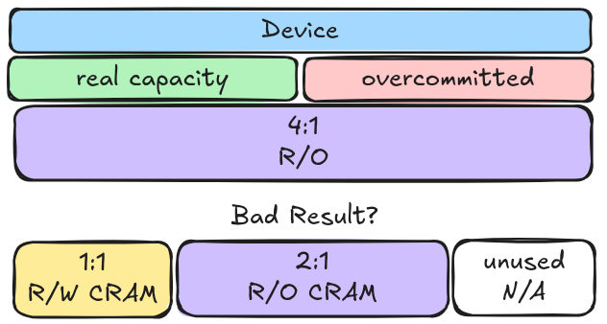
Voiced Concerns - R/O Perf
Should be able to resize at runtime (hotplug).
R/W region can hold File.
Still need allocation control.
Math is weird:
Global target ratio is actually like 2.5X
Not worked on yet.

Slide 11
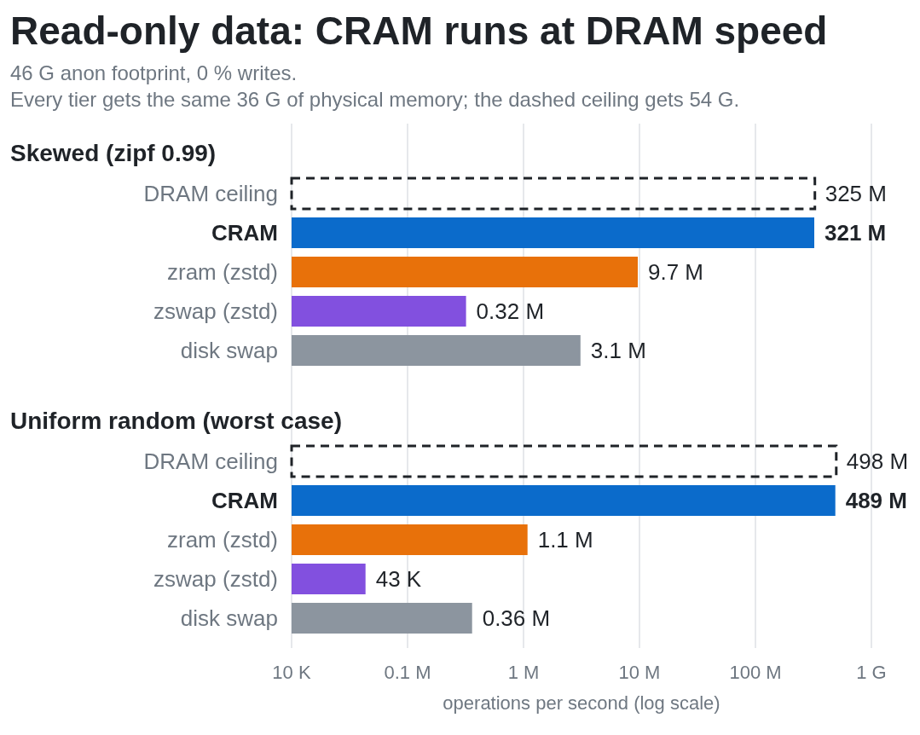
*all DRAM-backed to isolate fault cost
*zswap had a reclaim stall issue that was unrelated, so the results for
zswap are actually
not entirely valid
**** Log Scale!

Slide 12
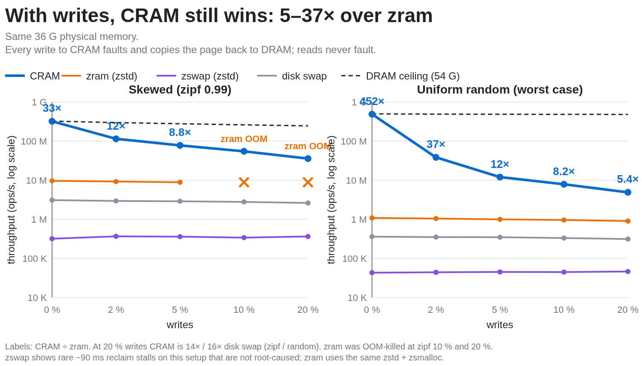

Slide 13
